Slide 1
Green Building Retrofitting Trends and
Certification Requirements
City of Milwaukee
Emerging Business Sustainable Conference
presented by
Carter Dedolph Erick Shambarger Ada Duffy
Focus on Energy
City of Milwaukee
Office of Environmental Sustainability
Milwaukee Lead/Asbestos
Information Center

Slide 2
Workshop Purpose
Explain new business opportunities in the green building market, including existing Focus on Energy programs and the new city-scale energy retrofit program called ME^{2.}
Describe what certifications are necessary for contractors to participate in these programs
Describe how certifications can be obtained

Slide 3
What is Focus on Energy?
Wisconsin’s statewide resource for energy efficiency and renewable energy
Legislature created the program in 1999; expanded in 2005
Helps implement projects that would not occur otherwise
Customer eligibility based on their electric and/or natural gas utilities

Slide 4
Focus on Energy Offers…
Residential, Business and Renewable Energy Programs
  Single and multifamily homes
  Commercial, industrial, agricultural and school/government buildings
Education, technical expertise and financial assistance

Slide 5
Focus Accomplishments
Over 85,000 businesses and over 1.3 million residents have already participated in Focus on Energy
More than 3,000 market provider partnerships statewide
By mid-2009, Wisconsin’s residents and businesses were saving more than $268 million annually as a result of Focus on Energy programs
Notes:
We refer to our trade allies, retailers, etc. as “market providers”

Slide 6
Agenda
Green Building
Home Performance with ENERGY STAR
  Focus on Energy’s Existing Home Program
Retrofitting Trends
ME² Program
Certifications and Training Opportunities

Slide 7

What is a Green Building?

Slide 8
Energy
and
Atmosphere
Sustainable
Sites
Innovation
in
Design
GREEN Building
Water
Efficiency
Indoor
Environmental
Quality
Materials
and
Resources

Slide 9



Many Different Programs

Slide 10
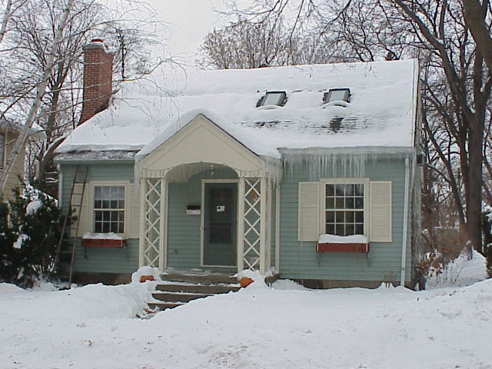
Existing Homes

Slide 12
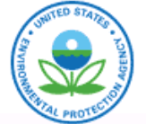

Slide 13
Home Performance with ENERGY STAR
Nationally
24,000 Home Performance with ENERGY STAR projects nationally
Over 30 utilities, state energy offices, public benefit programs, non-profits, and contractors
Programs are at regional, state, and local levels

Slide 14
Home Performance with ENERGY STAR
Wisconsin
1,950 Home Performance with ENERGY STAR completed projects in 2009
55% post assessments/pre assessments
75% completions implemented 3 or more measures

Slide 15
Participants
Homeowner
Consultant
Installing Trade Ally

Slide 16
Consumer Program Participation Paths
Homeowner
Consultant
Installing Trade Ally
Homeowner
Trade Ally
Consultant
Installing Trade Ally

Slide 17
Consultants
Independent businesses
  Offer a variety of options above and beyond Program’s required assessments
Work for the homeowner as compared to a contractor
Third party recommendations on the measures a homeowner needs
Perform a full energy evaluation of your home
  Includes performance testing of ventilation and mechanical systems, combustion safety testing, building tightness, and insulation levels

Slide 18
Consultants
Provide a written report outlining suggested changes and help determine next steps
Will suggest Trade Allies that do the work to the Program’s standards
After the work is complete, consultant returns to provide independent verification the work was done correctly and re-test for combustion equipment if necessary

Slide 19
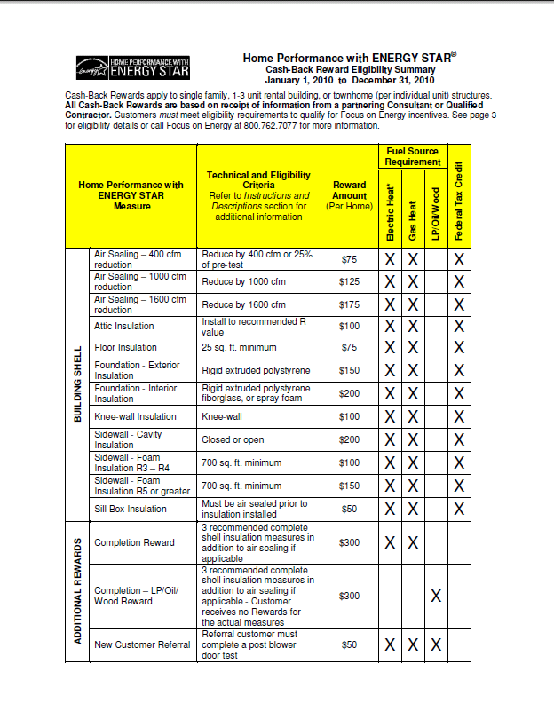
Cash-Back Rewards
http://www.focusonenergy.com

Slide 20
Consultant Selection
Building science experience
Business experience
Verbal and written communication skills
Computer skills
Customer service skills
Application process

Slide 21
Consultant Program Training
Two week classroom and field training by Program Staff
  2 trainings per year
  10 – 12 candidates per training
RESNET Home Energy Rater certification
BPI Building Analyst certification
Mentoring in the field by Program Staff for first 3-5 projects

Slide 22
Consultants – After Training
Program expectations and protocols
  Signed agreement for participation
Quarterly meetings
Tech exchanges
CEU requirements
Homeowner surveys after completion
Program QA/QC for a certain number of jobs

Slide 23
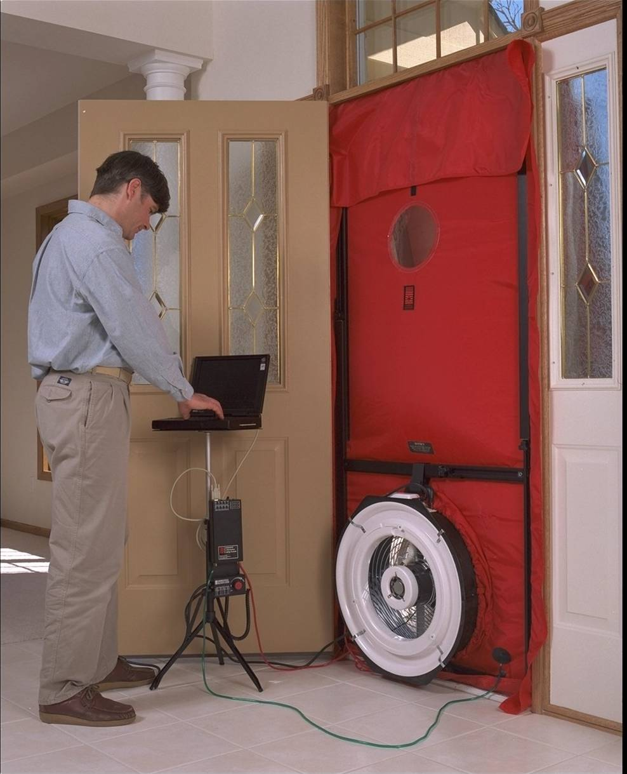
Consultant Services
Primary focus is on building shell to deliver whole-house building performance
Service includes pre and post evaluations
  Blower door
  Diagnostics
  Combustion safety
Delivered for fee
Notes:
The application of Building Science principles and methodologies as we perform retrofit work on houses.
A WHOLE-HOUSE APPROACH:
Using advanced diagnostics and a thorough understanding of scientific principles, we understand how houses operate better than ever before.
We use state-of-the-art materials and installation techniques that maximize the inherent efficiency of any given structure.
We re-design houses and in doing so, we “future-proof” them.
Looking at a building not as a combination of individual parts, but as an integrated and dynamic system.

Slide 24
Trade Allies
Installing Trade Allies - contractors
  Installs reward measures
  Requires Retrofit Clinic
Referring Trade Allies
  Does not install reward measures
  Requires Introductory Webinar
Both types of Trade Allies
  Partner with a Consultant
  Eligible for coop marketing $

Slide 25
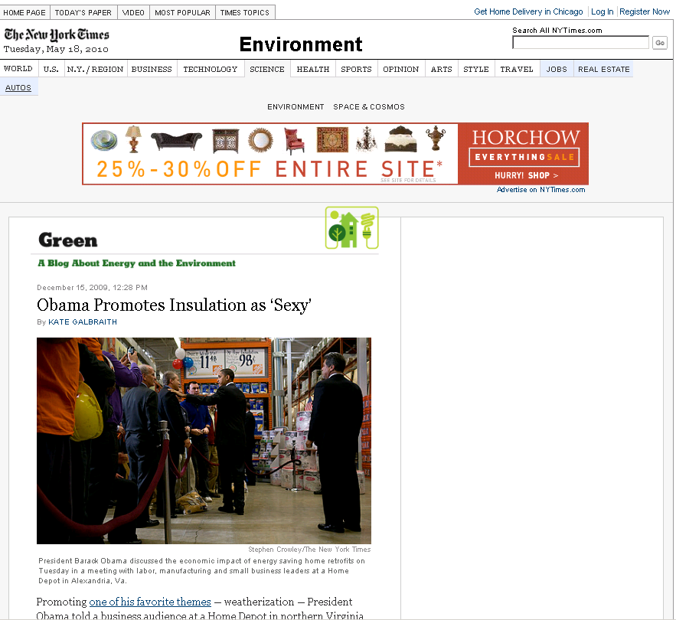
Trends

Slide 26
Completion History

Slide 27

Milwaukee Energy Efficiency Program (ME2)
Cities of Milwaukee, Madison, and Racine were awarded $20 million from the federal government to launch a $100 million community-wide retrofit program
Program will follow Focus on Energy Home Performance with ENERGY STAR protocol
ME2 will provide an innovative loan program to homeowners to finance energy retrofit work
ME2 will coordinate a large scale marketing campaign for energy efficiency
Milwaukee
Office of Environmental
Sustainability

Slide 28
Certified Contractors
Wisconsin Energy Conservation Corporation will issue RFQ for certified contractors for ME²
  Qualifications will require Community Workforce Agreement provisions
  Contractor must be licensed, bonded, and insured
  Focus on Energy technical qualifications (to follow)
  EPA lead abate rules
  Waste disposal guidelines
  Register as a Focus on Energy Trade Ally
  Not disbarred by State and Federal authorities
Milwaukee
Office of Environmental
Sustainability

Slide 29
Community Workforce Agreement Provisions
Milwaukee
Office of Environmental
Sustainability
Implement a Community Workforce Agreement for trades work in ME2
  Davis-Bacon (prevailing) wages
  Workers as employees of the contractor
  OSHA safety training
  40% utilization of Residence Preference Program Workers
  Utilization of apprentices and on-the-job trainees per DWD standards.
  New hires from qualified training programs
Coordination with Pathways Out of Poverty grant and workforce development partners to provide qualified workers

Slide 30

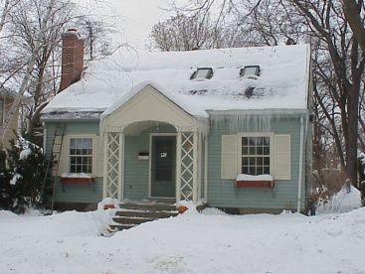
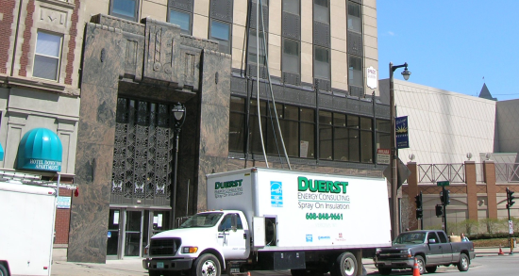
Certifications
Individuals
Homes
Companies

Slide 31


Slide 32
Building Analyst Professional
BPI Certified Professional
Building science (Fundamentals)
Buildings and their systems
Measurement and verification of building performance
BPI National Standards and Project Standards
Analyzing building systems

Slide 33
Envelope Professional
Building science (Intermediate)
Envelope and their interaction with other building systems
Measurement and verification of building performance
BPI National Standards and Project Standards
Optimizing building envelopes and their interaction with building systems

Slide 34
Air Sealing Installer
Dense – Pack Insulation Installer
Air Sealing Crew Chief
Dense – Pack Insulation Crew
Proposed certifications for professionals
Review and comment phase
Response to national Home Star legislation

Slide 35
Accredited Organization
BPI Accredited organization
An entity that complies with the requirements set by BPI to enhance the delivery of consistent, quality focused building performance services

Slide 36
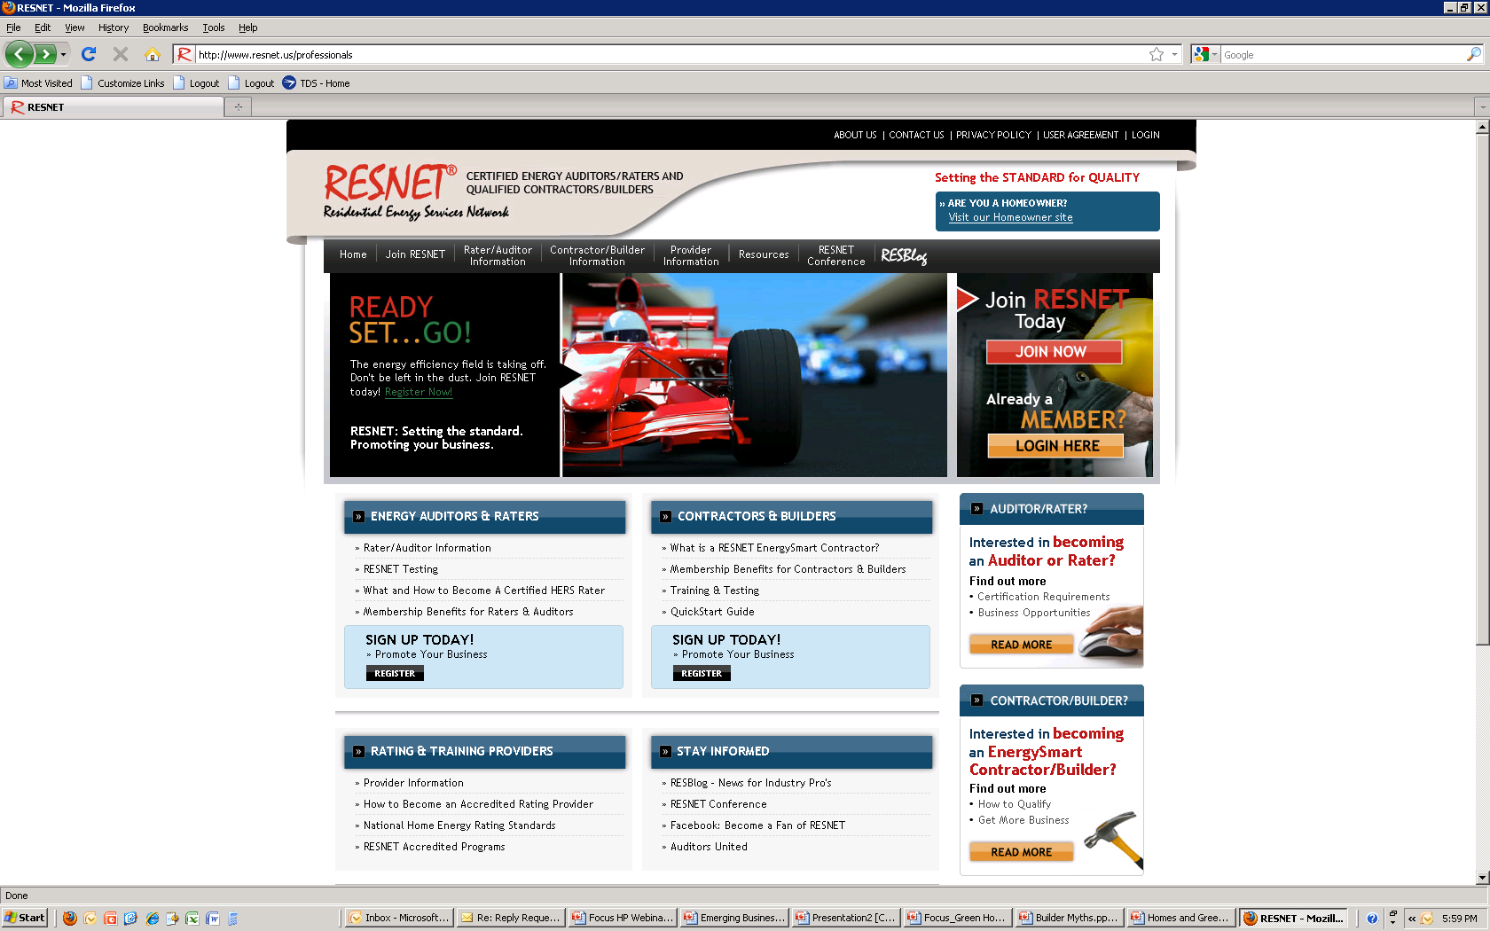

Slide 37
Home Energy Rater
  A person trained and certified by a rating Provider to perform the functions of inspecting and analyzing a home to evaluate the minimum rated features and prepare an energy efficiency rating
  Modeling REM/Rate or approved software
  Rating for the home using HERS Index

Slide 38
Trainings
Wisconsin Energy Conservation Corporation
Consultant Training Fall 2010 in Milwaukee
BPI Installer certifications when available

Slide 39
Thank You!
Questions?
Carter Dedolph
Senior Program Manager
Home Performance with ENERGY STAR
Wisconsin ENERGY STAR Homes
608.249.1271 ext 315
carterd@weccusa.org
Erick Shambarger
City of Milwaukee
Office of Environmental Sustainability
414-286-8556
eshamb@milwaukee.gov
Ada Duffy
Milwaukee Lead/Asbestos
Information Center, Inc
414-481-9070
ada@mlaic.com

